Slide 1
National History Day & the Archives
Kathleen Barker
Andrea Cronin
Kerin Shea
New England Archivists
Spring Meeting
22 March 2014
Portsmouth, NH

Slide 2
Who Are We?
Kathleen Barker (MHS)
Assistant Director of Education
MHD Board Member
Andrea Cronin (MHS)
Assistant Reference Librarian
Library liaison for National History Day researchers
Kerin Shea (MHD)
Northeast District Coordinator
MHD Board Member

Slide 3
What is National History Day?
Annual, nation-wide competition for middle- and high-school students
Teaches research skills, critical thinking, historical thinking, and communication skills
Projects connect to an annual theme
Requires use of primary source materials
Competition takes place in the spring at the local, state, and national levels
Encourages teens to nerd out about history!

Slide 4
The Process
Theme announced
Participants choose topic, begin research
Participants form thesis, select presentation category
Submitted projects judged, refined, judged again
Winners & awards

Slide 5
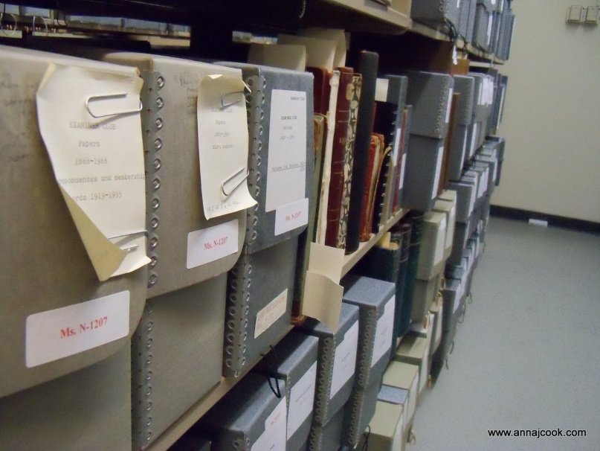
Why Should Archivists Care?
Students seek out our help
NHD is an opportunity for outreach
History Day is great fun – consider volunteering!
Closed stacks,
Massachusetts Historical Society

Slide 6
Massachusetts Historical Society’s NHD Tips & Tricks
Andrea Cronin
New England Archivists
Spring Meeting
22 March 2014
Portsmouth, NH

Slide 7
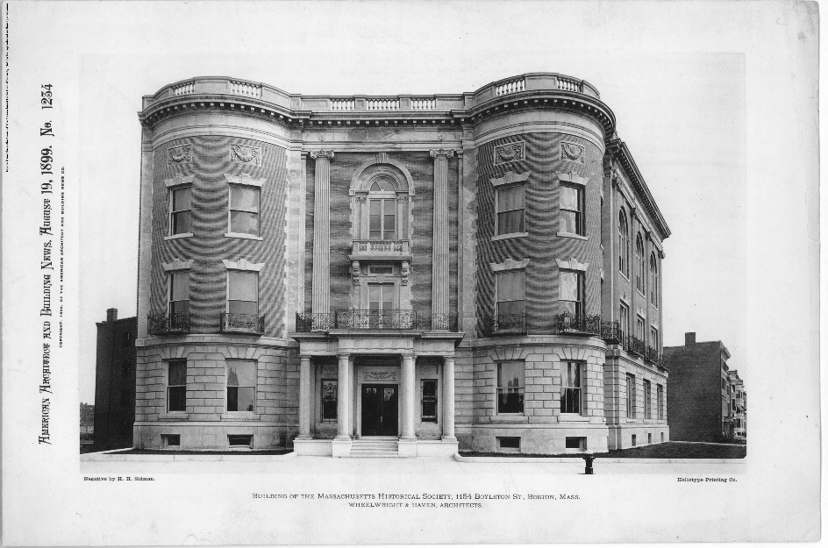
Who are you, who who who who?
A simple but precise explanation of your institution’s purpose and services will go a long way in helping students understand how your institution can provides resources for their NHD projects.
Massachusetts Historical Society (1899)
http://www.masshist.org/database/203

Slide 8
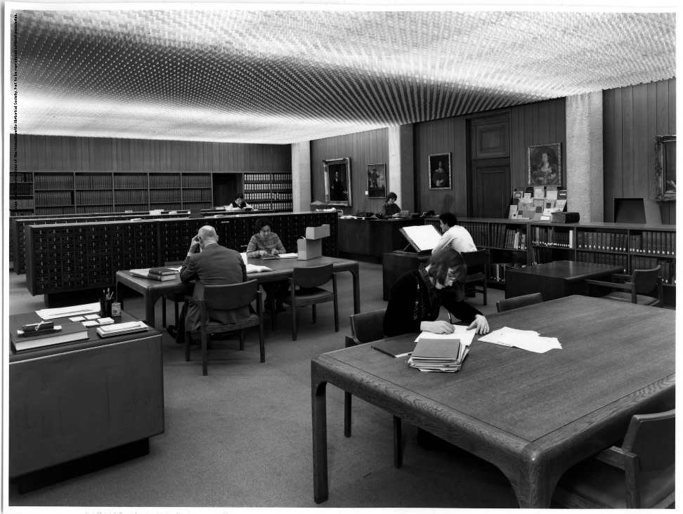
Help Students to Prepare
Letting students who wish to visit know your policies and procedures before they arrive will aid the research process.
Well-prepared students arrive with purpose and enthusiasm!
Reading Room, MHS (1984)
http://www.masshist.org/database/199

Slide 9
Know Your Neighbors!
The process of referral will help students understand historical research and how to locate information across institutions.
Bonus: You’ll look like a superhero for finding more resources!
http://bit.ly/O2f9yM
http://bit.ly/1gYcgaQ

Slide 10
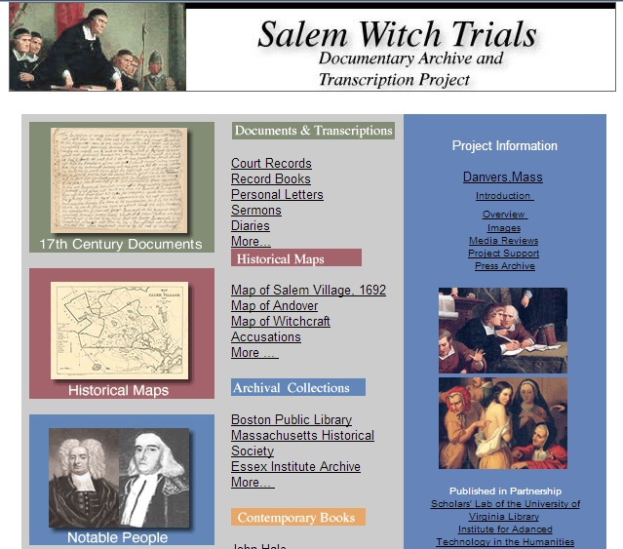
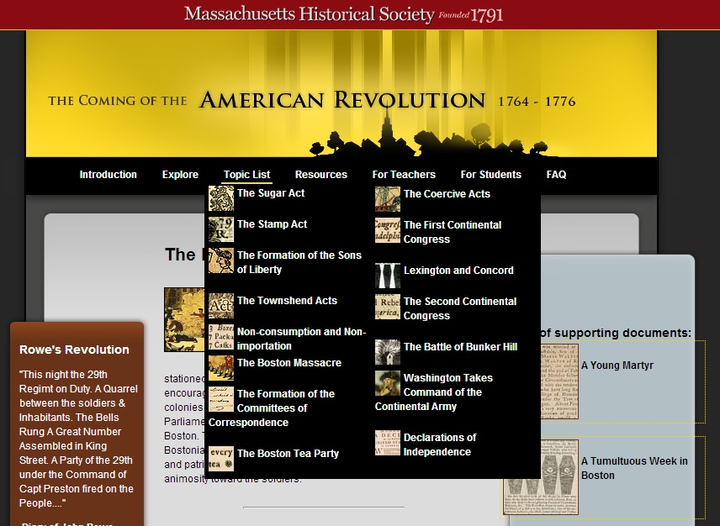
NHD @ MHS

Slide 11
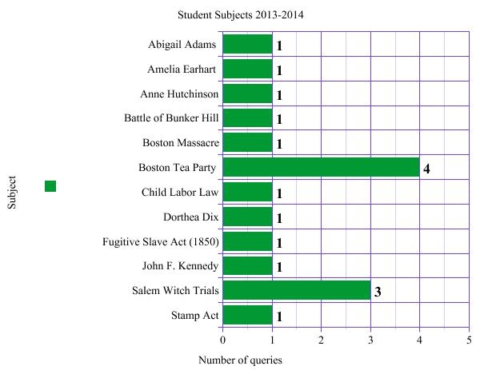
NHD @ MHS

Slide 12
History Day Projects by Massachusetts Students
Kerin Shea
New England Archivists
Spring Meeting
22 March 2014
Portsmouth, NH

Slide 13
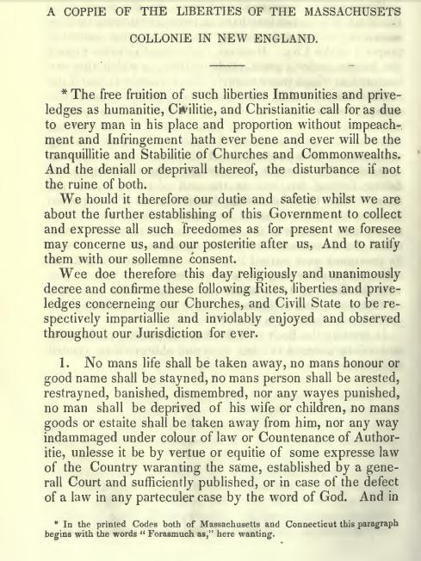
Unalienable Rights: The Massachusetts Body of Liberties of 1641 Senior Historical Paper
Zack Armand St. John’s Prep, Danvers, Mass.
New England Archivists
Spring Meeting
22 March 2014
Portsmouth, NH

Slide 14
Essex County Abolitionists Senior Group Documentary
Josh Raposa, Madison Hofmeester, and Matthew Maderia St. John’s Prep, Danvers, Mass.
New England Archivists
Spring Meeting
22 March 2014
Portsmouth, NH

Slide 15
Tinker v Des Moines Senior Group Performance
Sarah Herlihy, Jessica Herlihy, Hannah Farnham, Annie Tuttle Hamilton-Wenham Regional High School
New England Archivists
Spring Meeting
22 March 2014
Portsmouth, NH

Slide 16
Q & A
Kathleen Barker kbarker@masshist.org
Andrea Cronin acronin@masshist.org
Kerin Shea MAHistoryDay@aol.com
New England Archivists
Spring Meeting
22 March 2014
Portsmouth, NH

